Slide 1
Digital Image Processing CST382-3/IIT361-2

Slide 2
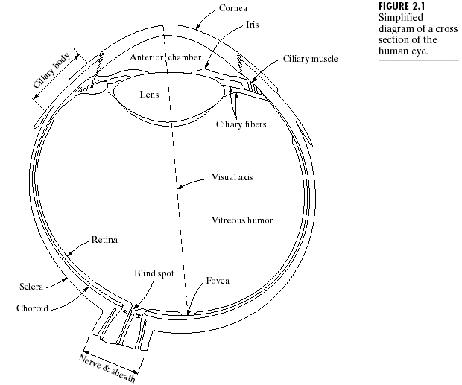
Elements of Visual Perception

Slide 3
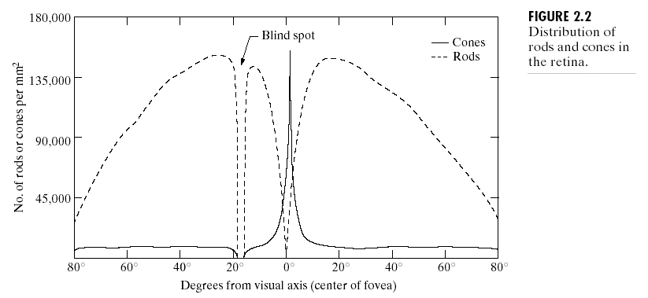
Cones & Rods
Notes:
Blind spot – no object recognition

Slide 4
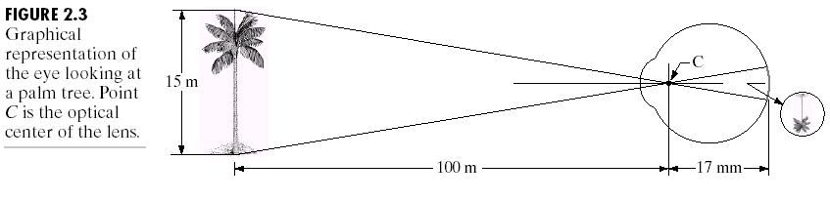
Image Formation

Slide 5
Image Sampling & Quantization
To create a digital image, we need to convert continuous sensed data into digital form.
Sampling
Quantization

Slide 6
Image Representation
To convert it to digital form, we have to sample the function in both coordinates and in amplitude.
An image may be continuous with respect to the x‑ and y‑coordinates and also in amplitude.

Slide 7
Image Representation
Digitizing the coordinate values is called sampling.
Digitizing the amplitude values is called quantization.

Slide 8
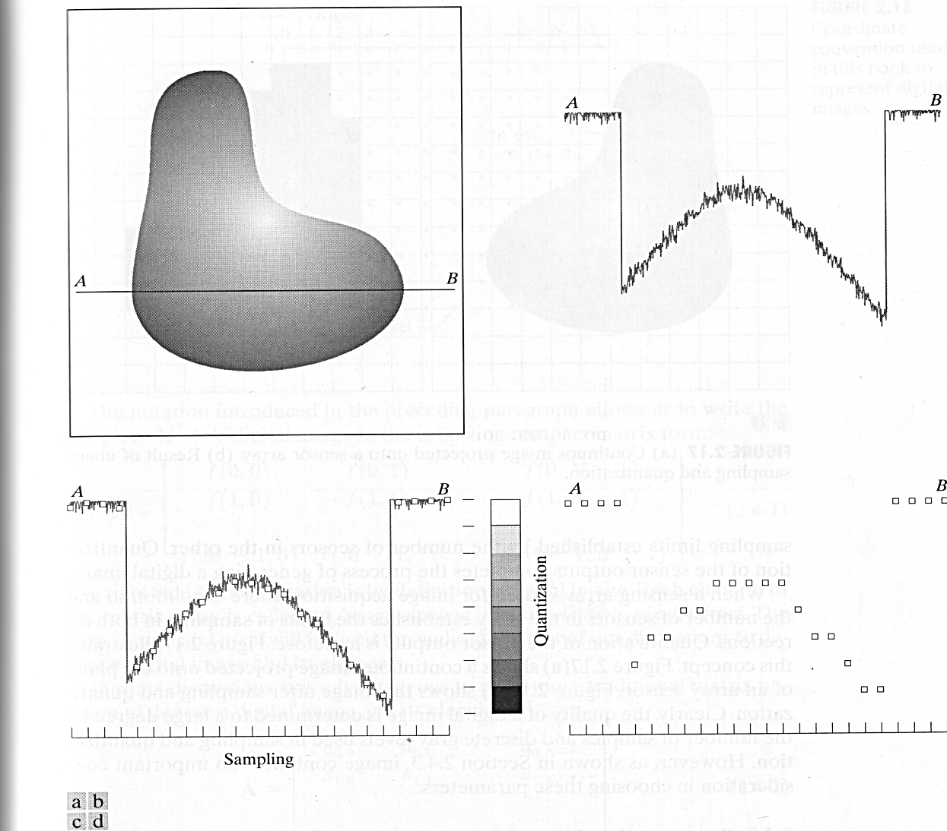
Image Representation
Fig 3.1 Generating a digital image (a) Continuous image. (b) A scan line from A to B in the continuous image. (c) Sampling & quantisation. (d) Digital scan line.

Slide 9
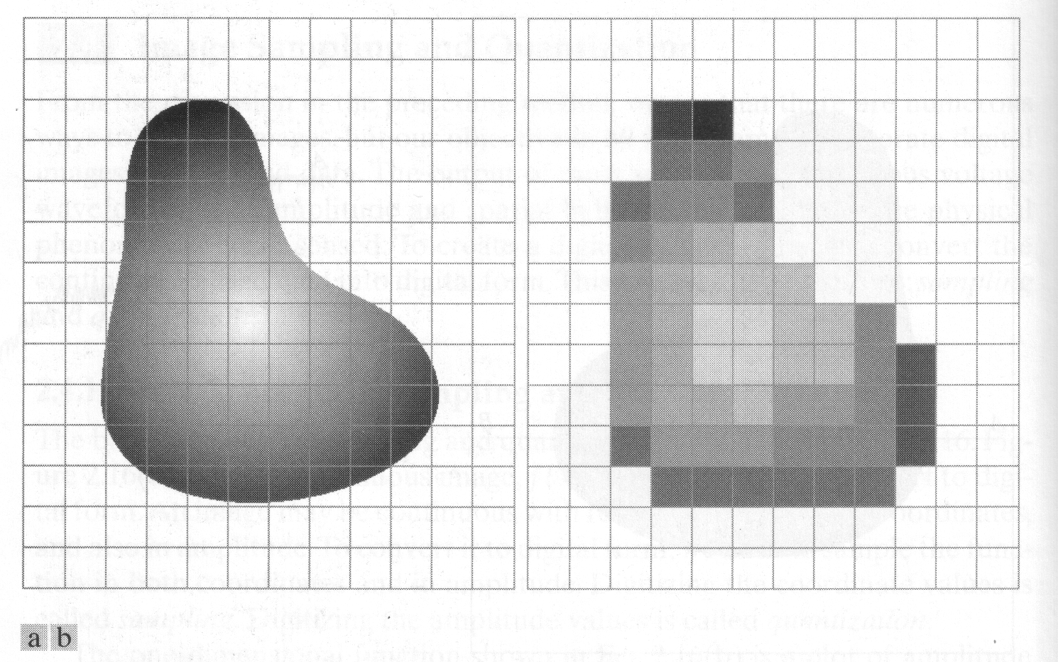
Sampling
Notes:
Continuous image, digitized image

Slide 10
Sampling
The result of sampling and quantization is a matrix of real numbers
The values of the coordinates at the origin are (x,y) = (0,0).
The next coordinate values along the first row are (x,y) = (0,1).
The notation (0,1) is used to signify the 2nd sample along the 1st row.

Slide 11
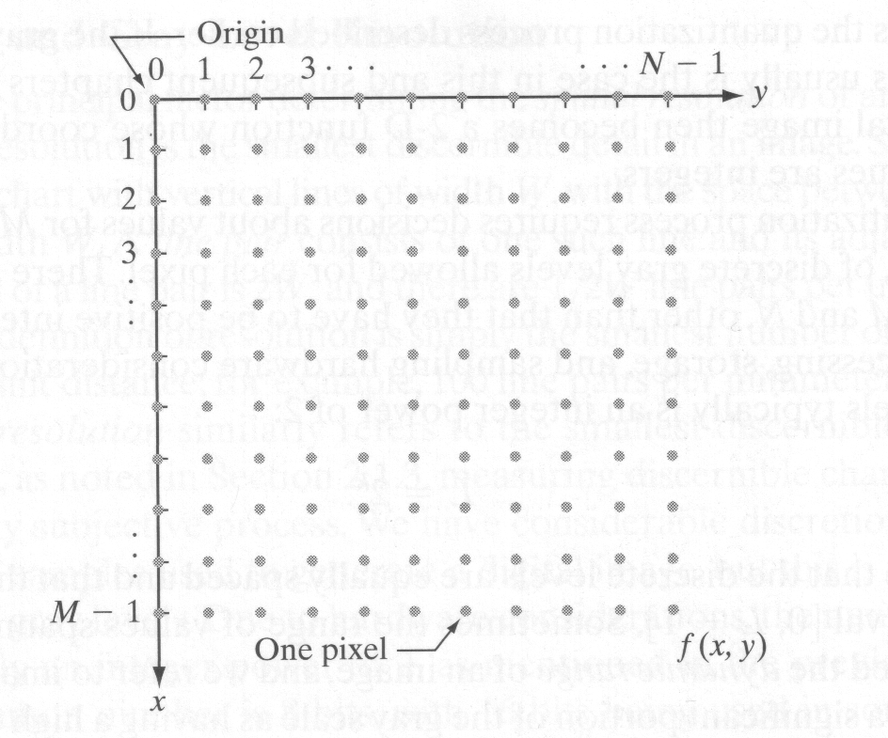
Sampling

Slide 12
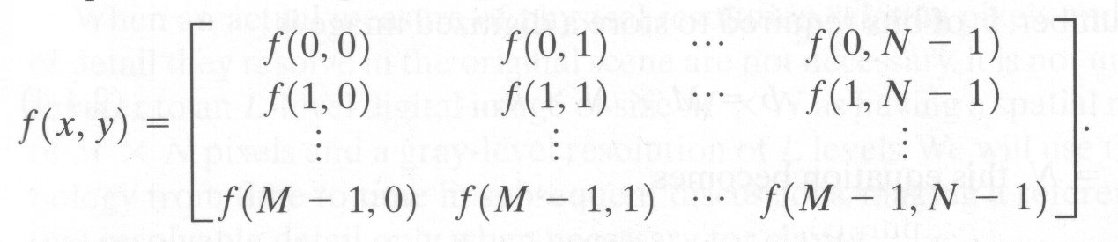
Digital Image

Slide 13
Digitized Image and Size
The number of bits required to store a digitized image is
b = M x N x k
Where M & N are the number of rows and columns, respectively.
The number of gray levels is an integer power of 2:
L = 2^{k} where k =1,2,…24
It is common practice to refer to the image as a “k-bit image”

Slide 14
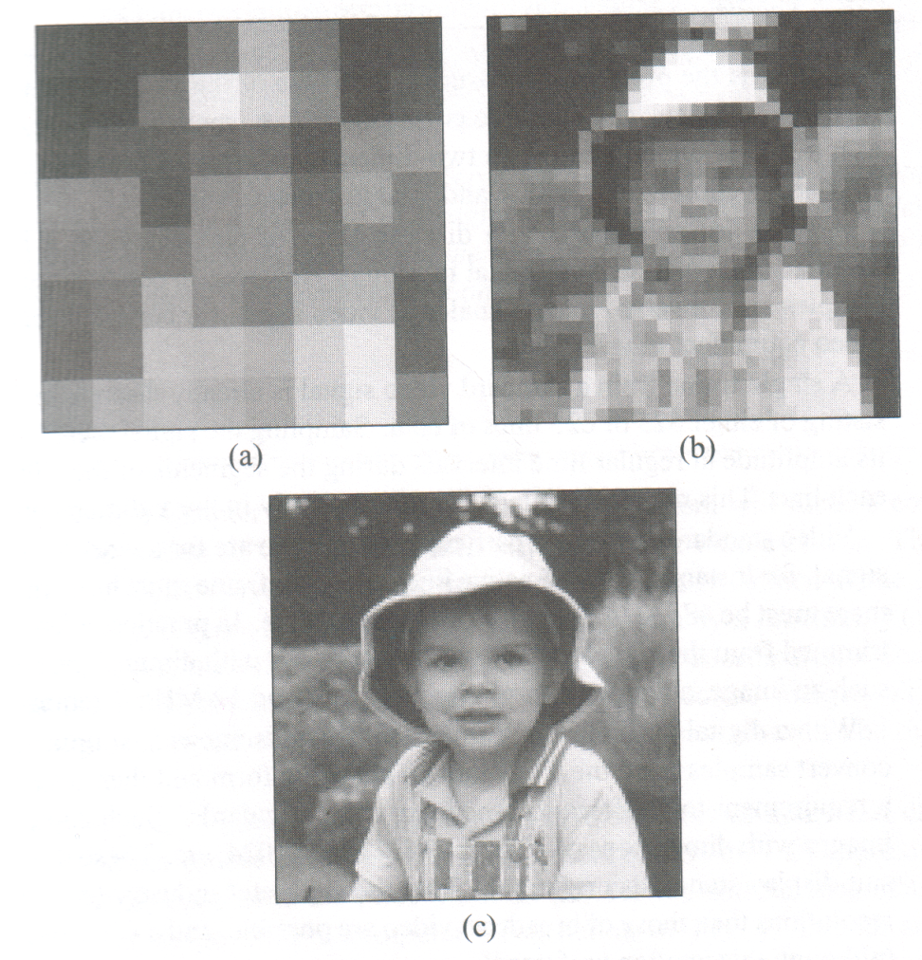
Resolution
Fig. 3.6 Effect of resolution on image interpretation (a) 8x8 image. (b) 32x32 image (c) 256x256 image
Notes:
Imresize(original, 4)

Slide 15
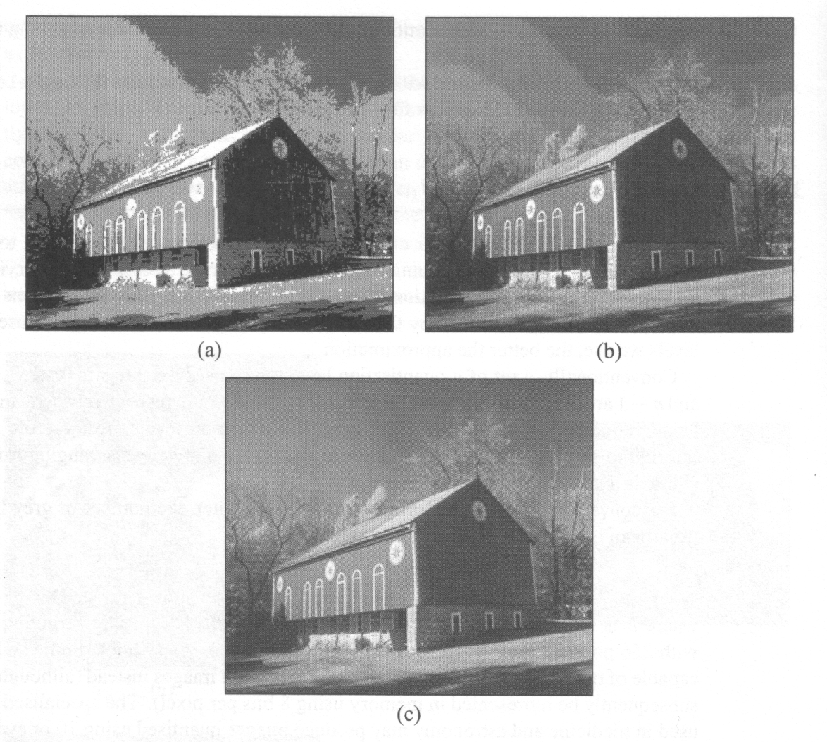
Effect of Quantization
Fig.3.7 Effect of quantization on image interpretation. (a) 4 levels. (b) 16 levels. (c) 256 levels

Slide 16
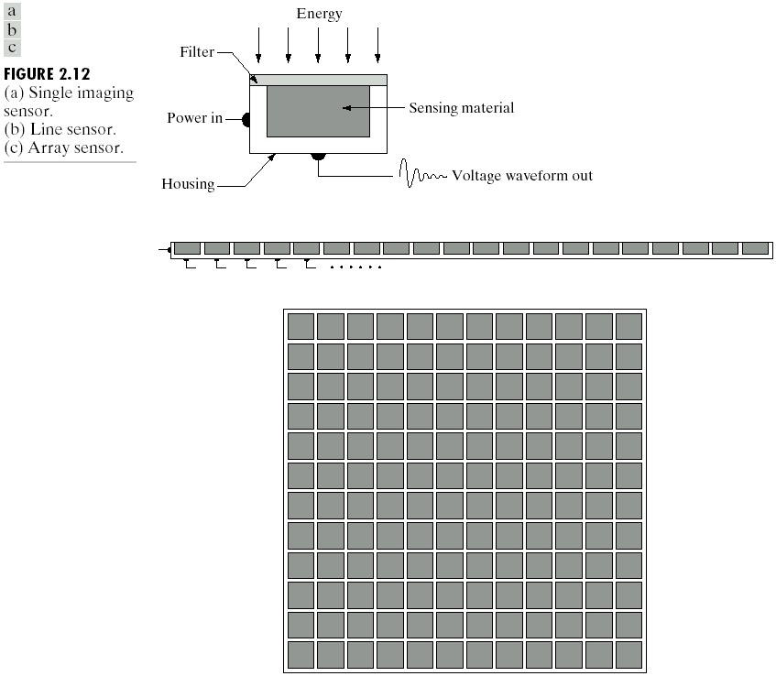
Image Sensing Acquisition

Slide 17
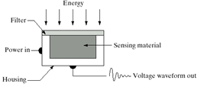
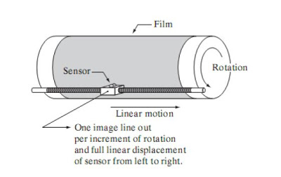
Image Acquisition – Single Sensor
Notes:
Inexpensive method to get high resolution images

Slide 18
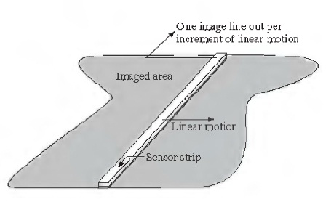
Image Sensing – Linear Sensor Strip
Notes:
Imaging system mounted on aircraft
4000 or more in a strip

Slide 19
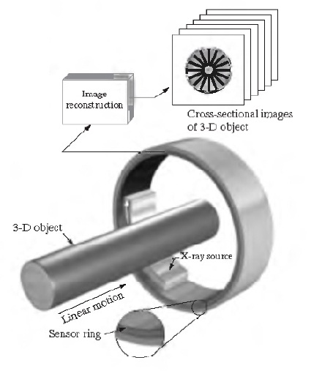
Circular Sensor Strip
Notes:
Medical and industrial imaging systems to get the cross section of the object

Slide 20
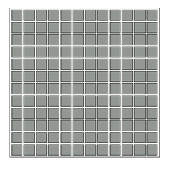
Image Acquisition – Array Sensor
Notes:
4000*4000 or more in array
Digital camera especially on astronomical application

